Slide 1
JAPAN USED CAR PRICE PREDICTION USING MACHINE LEARNING
PRESENTED BY: MANAN CHAUHAN
GUIDED BY: SAURAV KUMAR

Slide 2
CONTENT
Introduction
Objective
Dataset Review
Technology Used
DataFlow
Methodology
Exploratory Data Analysis
Results
Conclusion

Slide 3
INTRODUCTION
As our cities grow and continue to evolve, the rate of car ownership rises.
A car can help you facilitate many daily tasks. If you lead a busy life, a car can make your life so much easier. You can make better use of your time and efforts by owning a car.
Owning a car stops you from having to rely on schedules of public transports and gives you a sense of independence and self reliance.
As you go to buy yourself a car having the knowledge of what the current market prices are and the impact of different features on the price are is very important so to get the best possible deal.

Slide 4
OBJECTIVE
To predict used car prices using a dataset with ten features, including price, brand, model, registration year, mileage, engine capacity, transmission type, drive type, hand drive orientation, and fuel type.
Comparison among different Machine Learning Algorithms to identify the most accurate model for predicting the prices.

Slide 5
DATASET REVIEW
Car’s data was scraped from tc-v.com and it included Information about Japan's largest online used car marketplace. Ten features were assembled for each car in the dataset.
The dataset consists of 2,318 rows and 11 columns, providing detailed information on various features of used cars.
The dataset consists of numerical as well as categorical data.
The dataset had no null values as well as no duplicate values.
The dataset had some outliers that were handled.
The primary focus of the analysis is on predicting the car's ‘Price’ based on the other features.

Slide 6
TECHNOLOGY USED
Matplotlib
Matplotlib is especially deployed for basic plotting. Bars, pies, lines, scatter plots and so on are part of visualisation using matplotlib, Matplotlih is a graphics package well integrated with NumPy and Pandas. The MATLAB plotting commands are closely mirrored by the pyplot module.
Seaborn
Seaborn provides various visualization patterns. It has easy and interesting default themes and uses fewer syntax. Statistics visualization is the speciality of seaborn and it is employed while summarizing data in visuals and additionally depict the data distribution.
Linear Regression
Regression is a method for predicting a dependent component with the help of independent variables. The method is commonly used to predict and calculate correlations between independent and dependent variables. The regression model establishes a linear or exponential connection between independent and dependent variables.
Decision Tree
Decision Trees (DTs) are a non-parametric supervised learning method used for classification and regression. The goal is to create a model that predicts the value of a target variable by learning simple decision rules inferred from the data features. A tree can be seen as a piecewise constant approximation.
Random Forrest Regressor
Random forest regression model combines multiple decision trees to create a single model. Each tree in the forest builds from a different subset of the data and makes its independent prediction. The final prediction for input is based on the average or weighted average of all the individual trees' predictions.

Slide 7
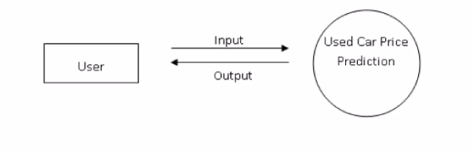
DATAFLOW
A data flow diagram shows the way information flows through a process or system. It includes data inputs and outputs; data stores and the various sub processes the data moves through. DFDs are built using standardized symbols and notation to describe various entities and their relationships.
True data is noisy. Therefore, it is necessary to clean data so that the actual information from the collected data can be acquired. Different processes are carried out to obtain the actual information such as manual encoding and one hot encoding. Then feature extraction is performed to extract necessary features. User can give an input to the detection model and it will provide an output.

Slide 8
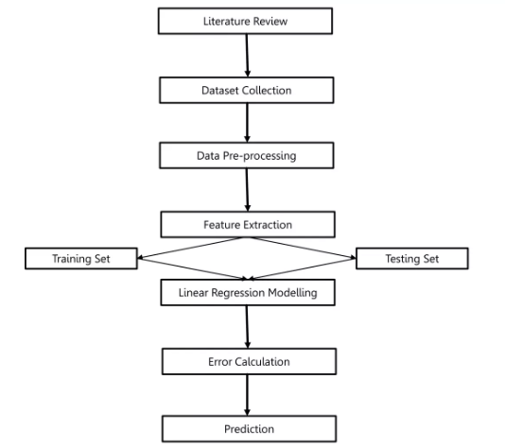
METHODOLOGY

Slide 9
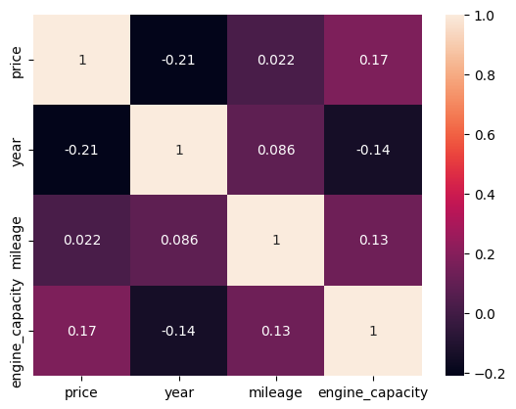
EXPLORATORY DATA ANALYSIS
Correlation between all the numerical features

Slide 10
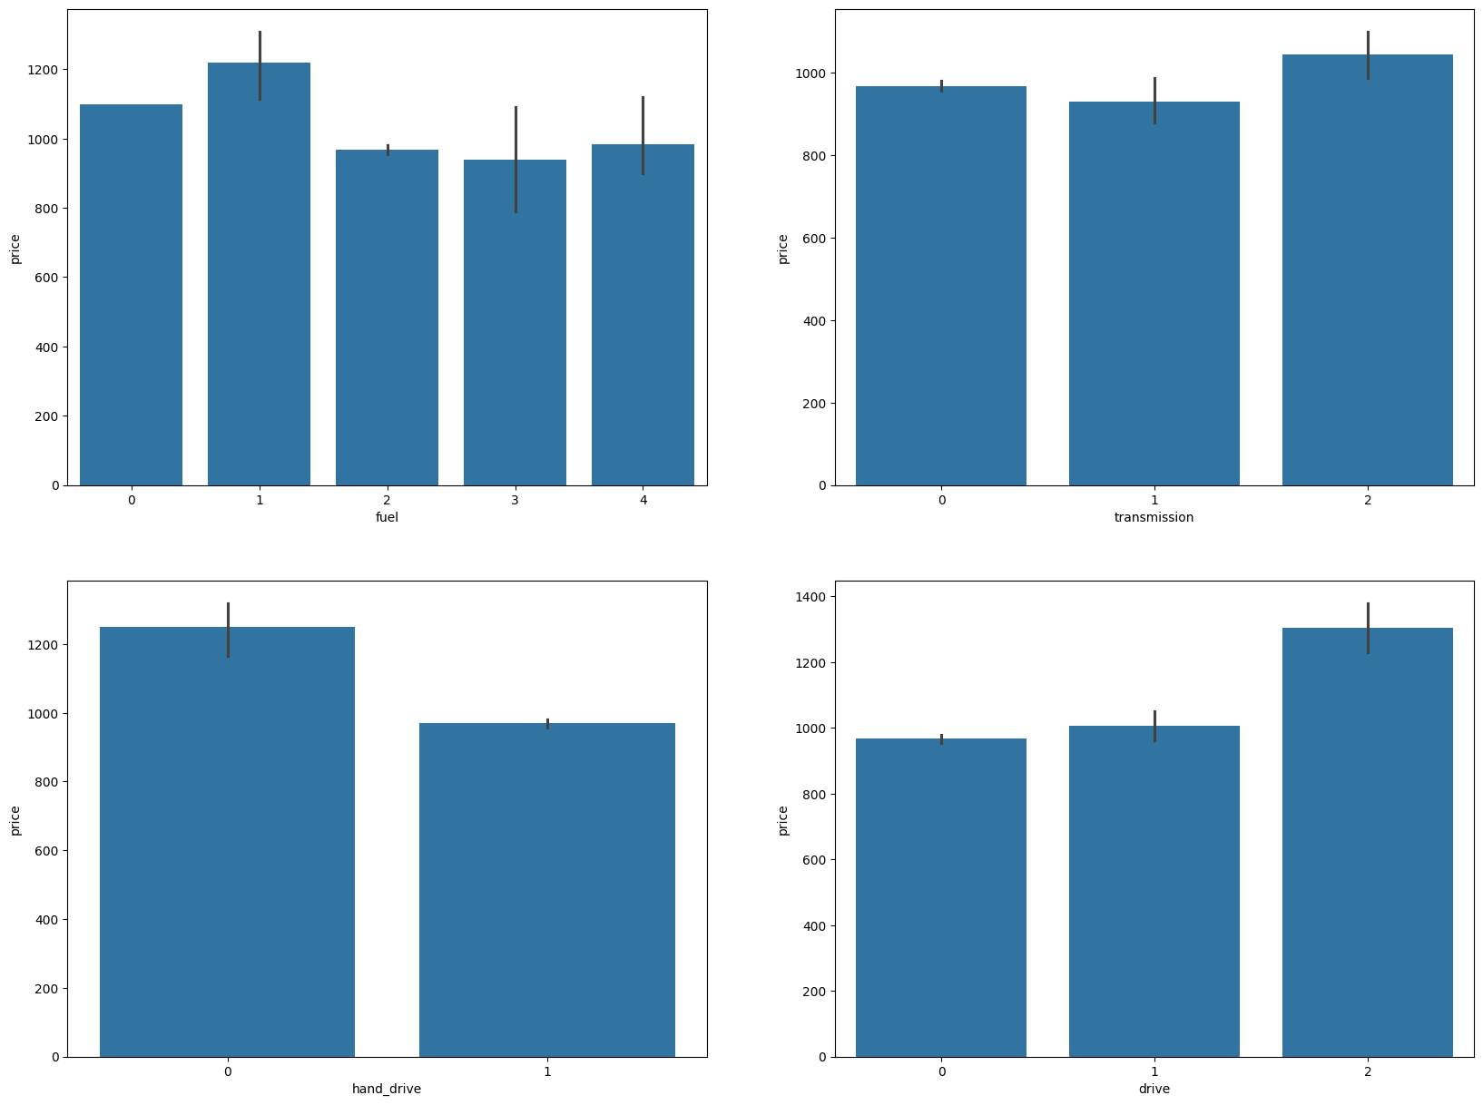
Prices vs Categorical Featues

Slide 11
RESULTS
Linear Regression Model
MAE 0.800500418265936
MSE 0.9185674651447495
RMSE 0.9584192533253647
R2 score 0.08755892649309993
Decision Tree Regressor Model
MAE 0.7685118939108567
MSE 0.8804177219141328
RMSE 0.9383057720775956
R2 score 0.17591962737920908
Random Forrest Regressor Model
MAE 0.7496791567460404
MSE 0.8202879706467188
RMSE 0.9056975050460936
R2 score 0.24432400534271714

Slide 12
CONCLUSION
The R2 score of Random Forest Regressor was the highest meaning that it’s predicitions are the most accurate among all the other Models.

Slide 13
THANK YOU

